Slide 1
Leveraging NLP Predictive Models for Suicide Prevention:
A Data-Driven Approach Using Reddit Data
Team 5
Philip Appiah
LakshmiPriya Palaparthy

Slide 2
Project inspired by Amanda Todd's Story
Amanda Todd was a 14-year-old Canadian girl from British Columbia who faced severe bullying and mental health challenges. After being exploited by a predator online, she became a target of harassment at school, which led to profound feelings of isolation and despair.
In 2012, Amanda shared her experiences through a powerful YouTube video and other platforms using flashcards, detailing her struggles with bullying and depression. Despite going viral, the video did not bring her the help she needed.

Slide 3
Problem Statement:
Suicide prevention is a critical public health issue. Early identification of individuals at risk of suicide through social media posts can significantly aid in intervention efforts.
This project aims to develop a predictive model using NLP techniques to analyze Reddit posts and identify individuals potentially at high risk of suicide.

Slide 4

Research Questions:
How can NLP techniques be applied to detect suicidal ideation in Reddit posts?
Which NLP model performs best in identifying high-risk individuals while balancing precision and recall?

Slide 5
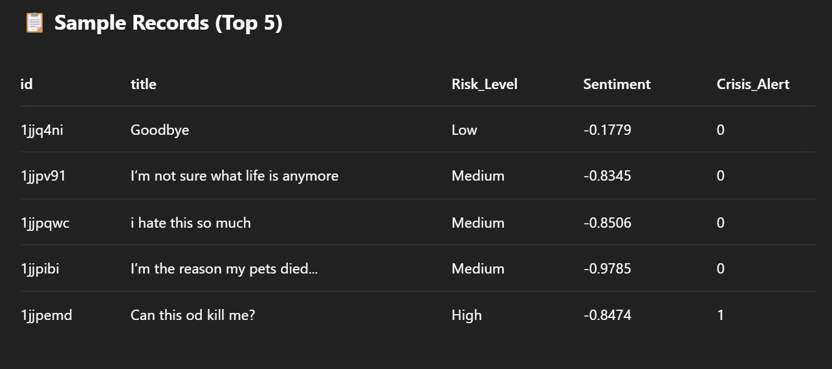
Data Collection:
Sourced data from mental health-related subreddits (e.g., r/SuicideWatch, r/depression) and neutral subreddits (e.g., r/AskReddit, r/happy) to create a balanced dataset.

Slide 6
Approach
Supervised Tasks:
Text classification: Used labeled dataset to train models to classify posts into risk levels (High, Medium, Low).
Feature extraction: Utilized TF-IDF vectorization to convert text data into numerical features for model training.
Unsupervised Tasks:
Exploratory data analysis: Applied visualization techniques to understand the distribution and characteristics of the data.
Variables:
Dependent variable: Risk level (High, Medium, Low).
Independent variables: Text content of posts, sentiment scores, posting time, etc.

Slide 7
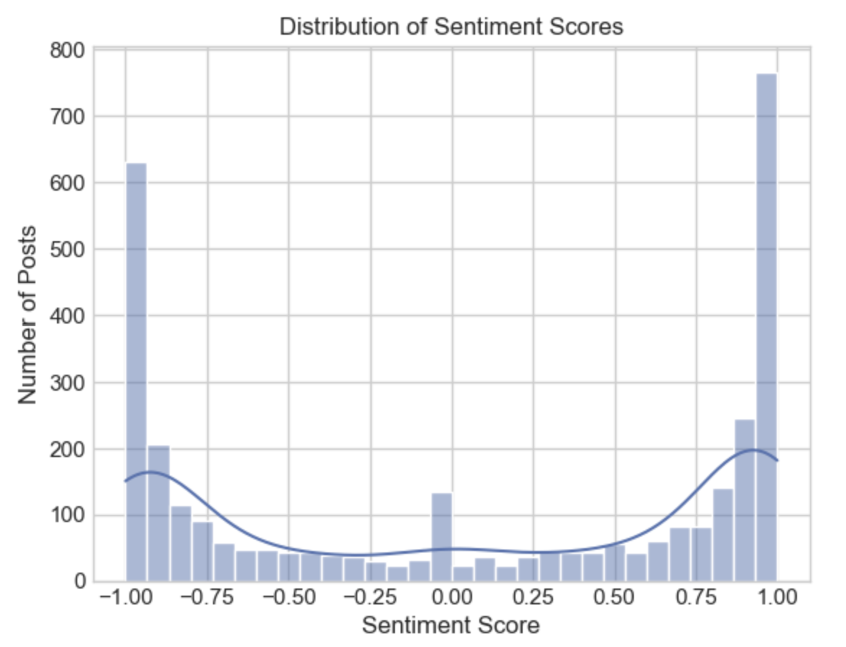
Exploratory Data Analysis:
Analyzed the distribution of sentiment scores, risk levels, and posting activity across different days of the week.

Slide 8
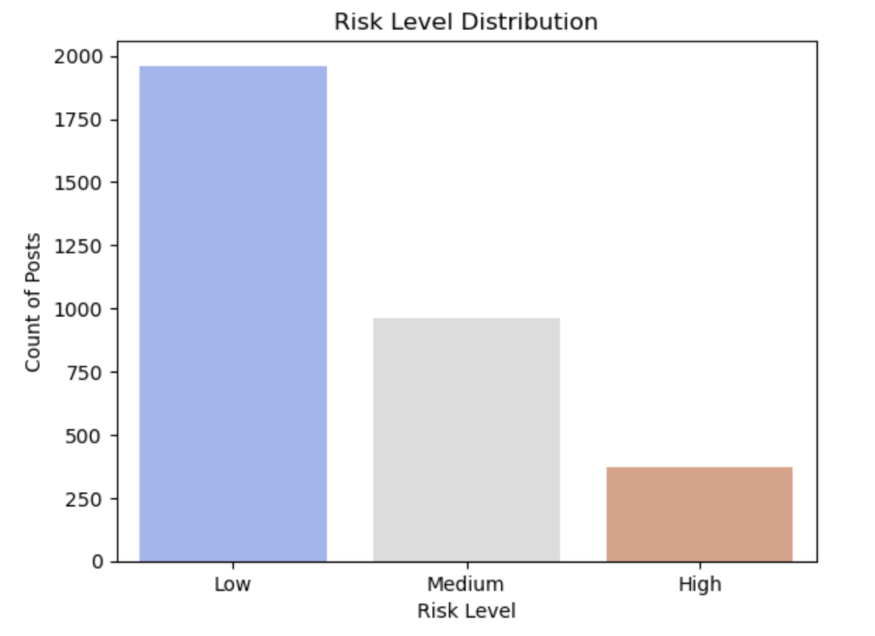
Exploratory Data Analysis:
Analyzed the distribution of sentiment scores, risk levels, and posting activity across different days of the week.

Slide 9
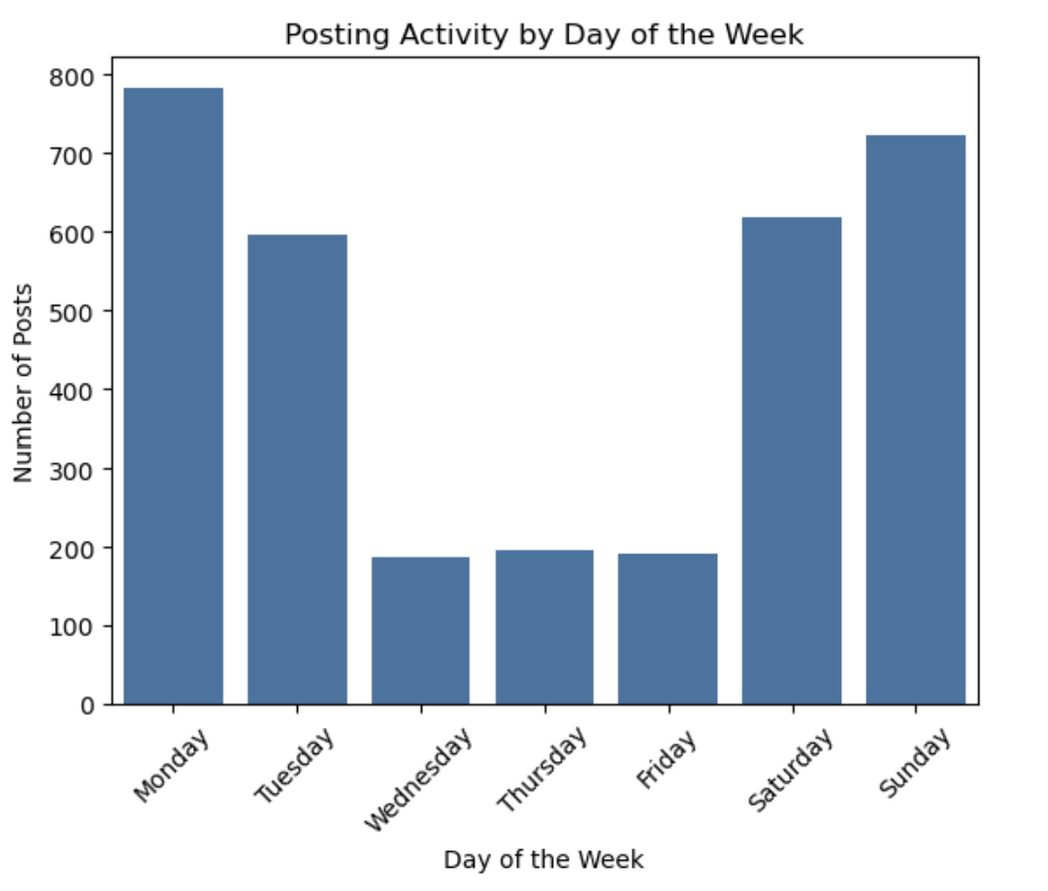
Exploratory Data Analysis:
Analyzed the distribution of sentiment scores, risk levels, and posting activity across different days of the week.

Slide 10
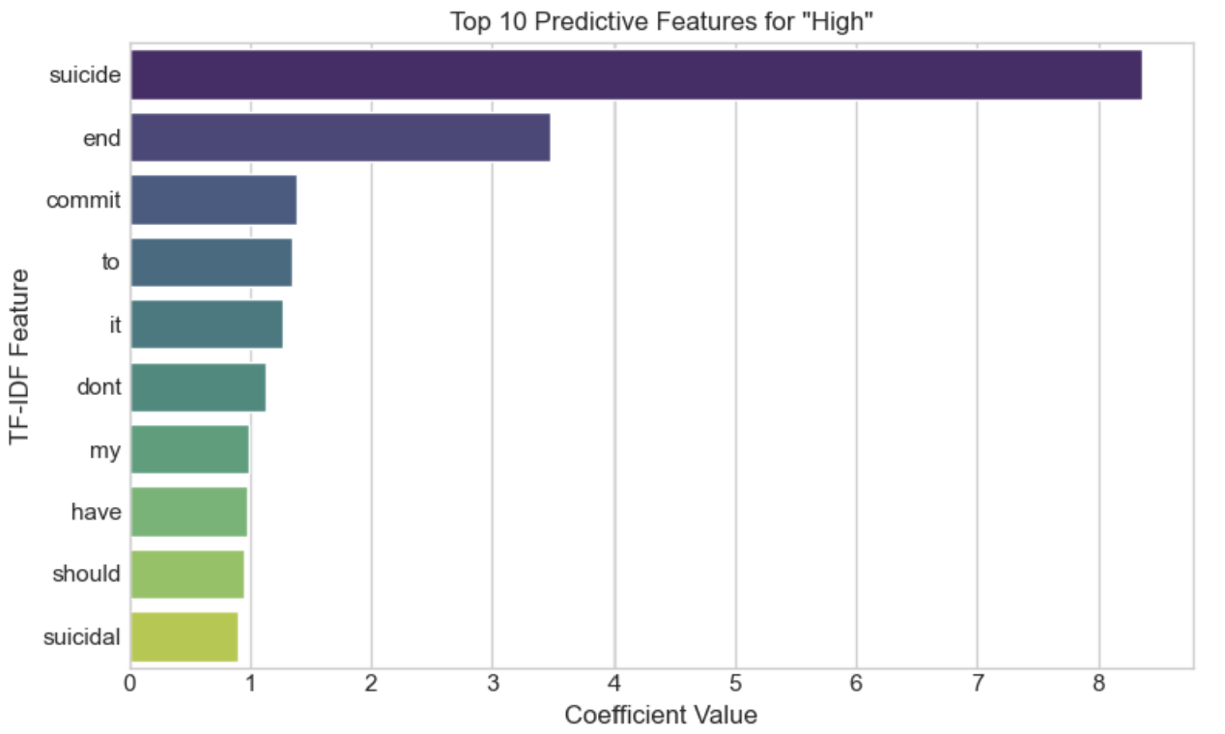
Each TF-IDF feature (word) gets a coefficient representing:
How much that word influences the prediction of a specific Risk_Level class.

Slide 11
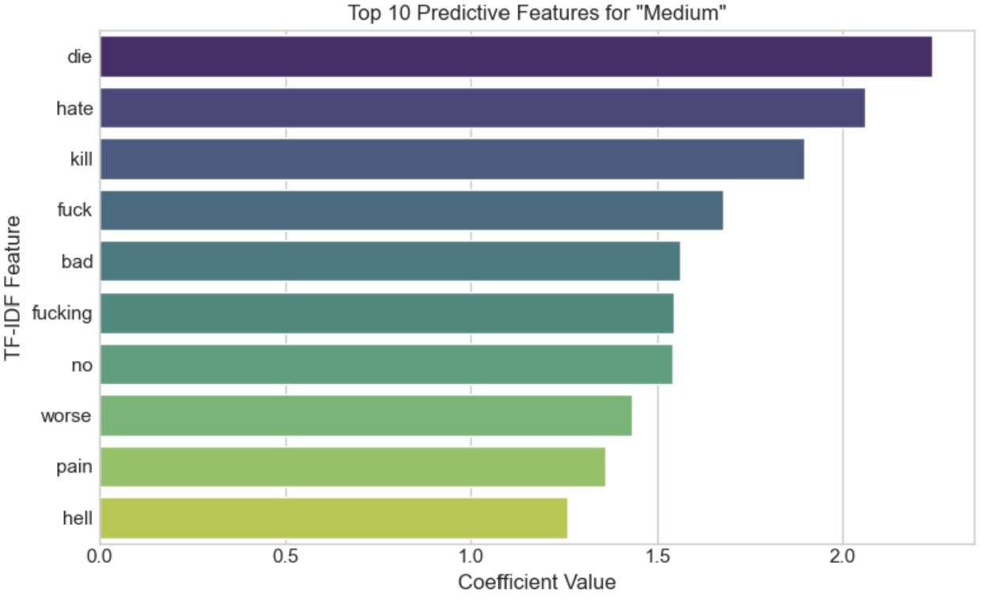
Each TF-IDF feature (word) gets a coefficient representing:
How much that word influences the prediction of a specific Risk_Level class.

Slide 12
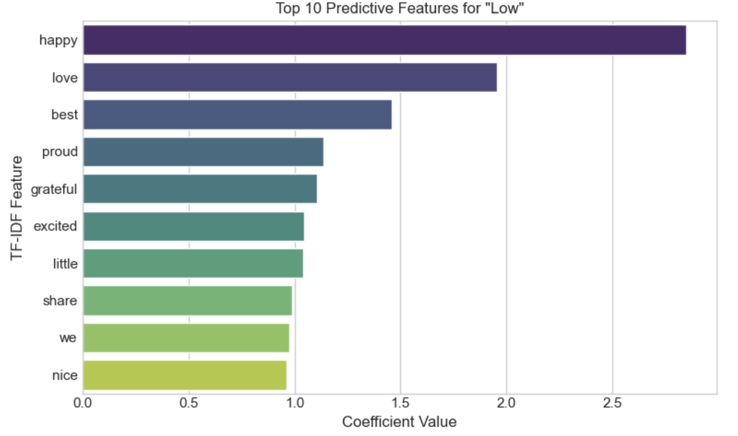
Each TF-IDF feature (word) gets a coefficient representing:
How much that word influences the prediction of a specific Risk_Level class.

Slide 13
Evaluating Model Performance in Imbalanced NLP Scenarios
In imbalanced NLP tasks like suicide risk detection, accuracy can be misleading.
Precision reflects prediction reliability, recall captures true high-risk cases, and the F1 score balances both—making it ideal when both false positives and negatives are critical.

Slide 14
Modeling: Trained, Tested and evaluated various ML Models
Traditional ML models (Logistic Regression, SVM, Random Forest, XGBoost)
01
Ensemble models (Voting Classifier, Stacking Classifier, Bagging Classifier, Boosting Classifier
02
Deep learning models (CNN, RNN, GRU, LSTM)
03

Slide 15
Traditional ML models

Slide 16
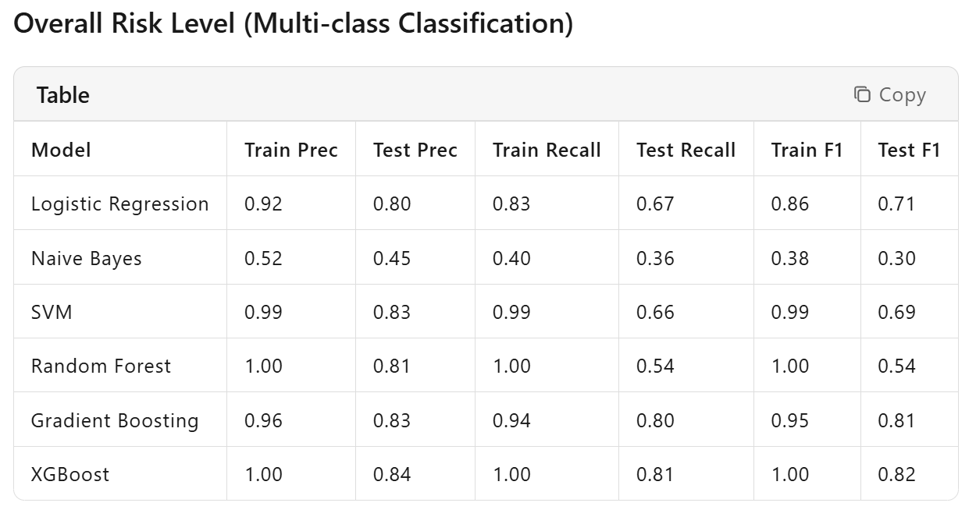
Traditional ML models
XGBoost demonstrates the highest precision, recall, and F1-score in testing, with a macro-averaged precision of 0.84, recall of 0.81, and F1-score of 0.82. It outperforms other models in terms of testing metrics and achieves a good balance of precision and recall, making it the best choice for overall risk level prediction.

Slide 17
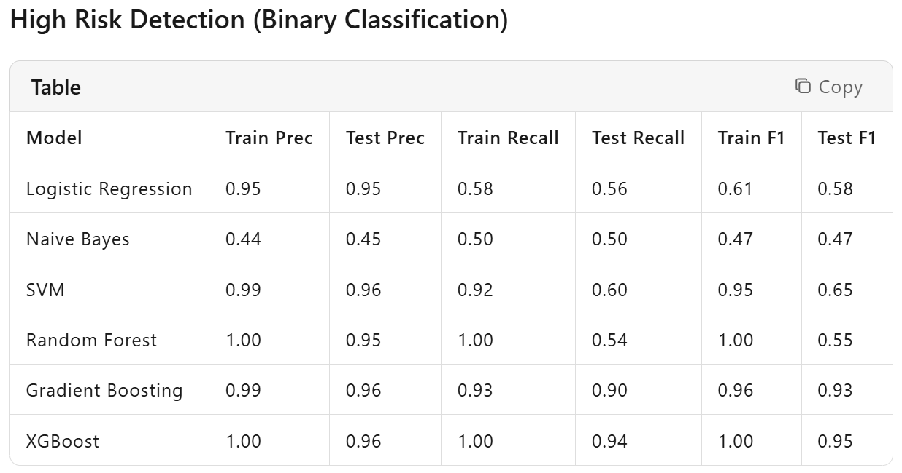
Traditional ML models
Gradient Boosting and XGBoost perform exceptionally well. XGBoost achieves the highest testing precision of 0.96 and F1-score of 0.95, while Gradient Boosting attains the highest testing recall of 0.90. However, considering the balance between precision and recall, XGBoost is slightly better.
Nevertheless, Gradient Boosting also shows strong performance. Given the critical nature of high-risk detection, where minimizing false negatives is crucial, Gradient Boosting, with its higher recall, may be more suitable. Thus, Gradient Boosting is chosen as the best model for high-risk detection.

Slide 18
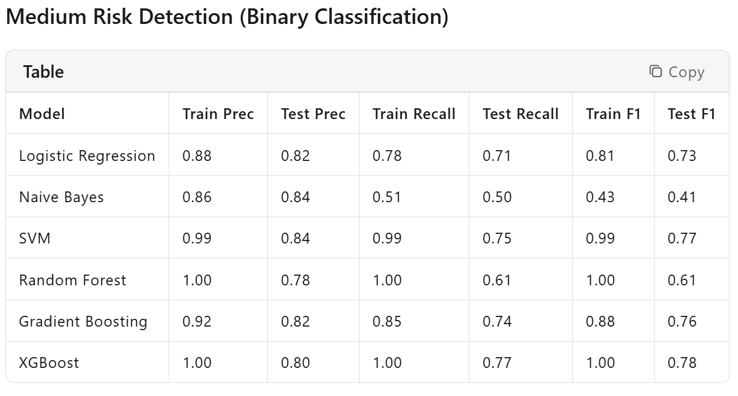
Traditional ML models
SVM and XGBoost perform better. SVM achieves the highest testing precision of 0.84 and F1-score of 0.77, while XGBoost reaches the highest testing recall of 0.77. SVM slightly outperforms in testing precision and F1-score, making it the best choice for medium-risk detection.

Slide 19
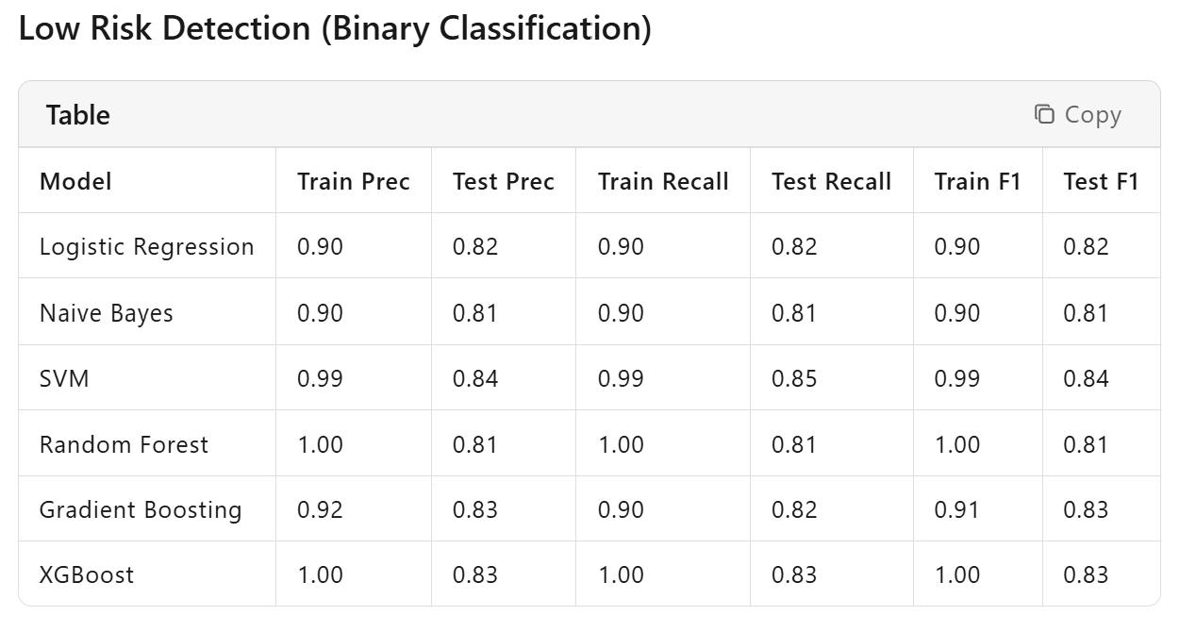
Traditional ML models
XGBoost, SVM, and Gradient Boosting perform relatively well. XGBoost and SVM achieve the highest testing precision of 0.83 and 0.84, respectively, while XGBoost also attains the highest testing recall of 0.83 and F1-score of 0.83. Therefore, XGBoost is the best choice for low-risk detection.

Slide 20
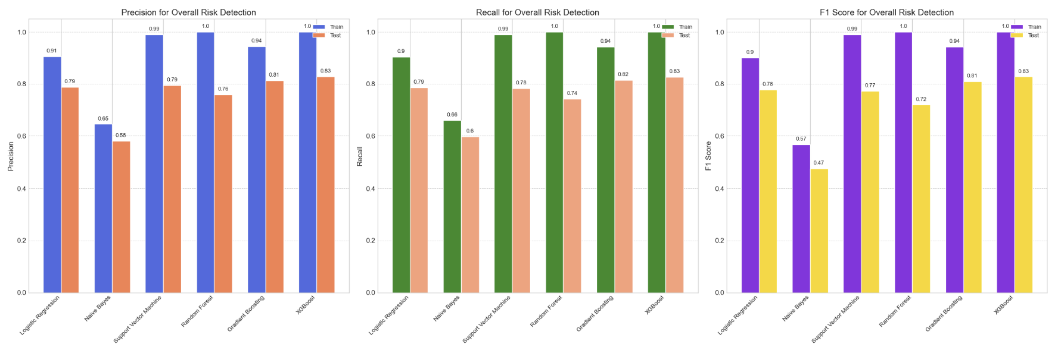
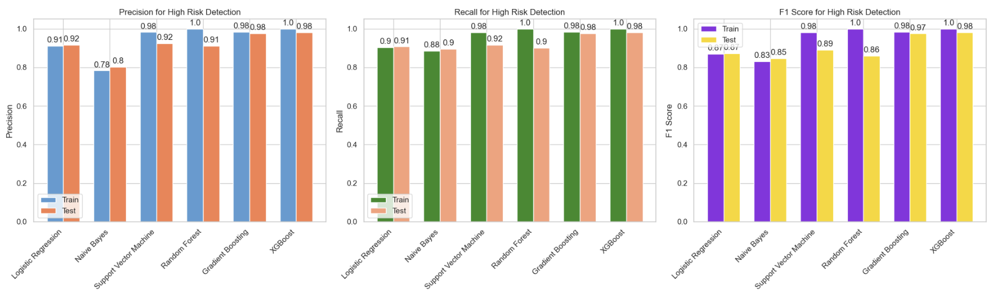
Traditional ML models

Slide 21
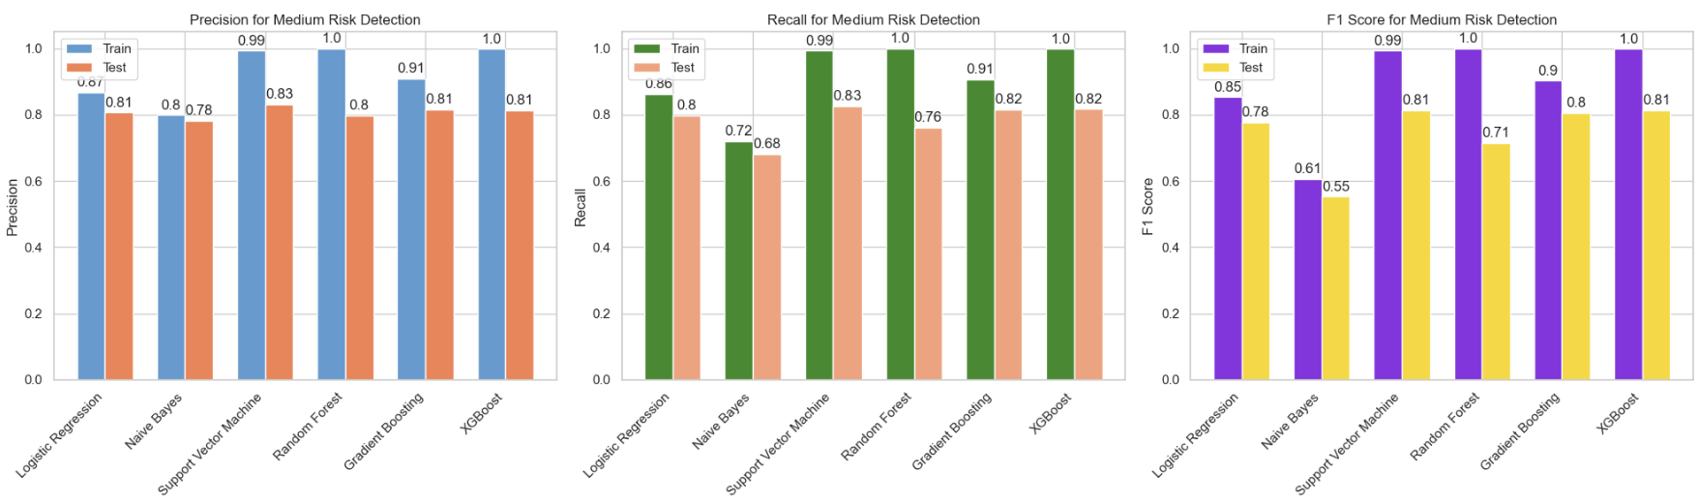
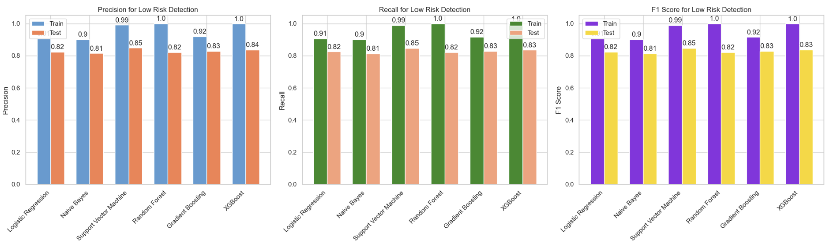
Traditional ML models

Slide 22

Best Traditional ML Models for Each Risk Level
Overall Risk Level: XGBoost
High Risk Detection: Gradient Boosting
Medium Risk Detection: SVM
Low Risk Detection: XGBoost

Slide 23
Ensemble models

Slide 24
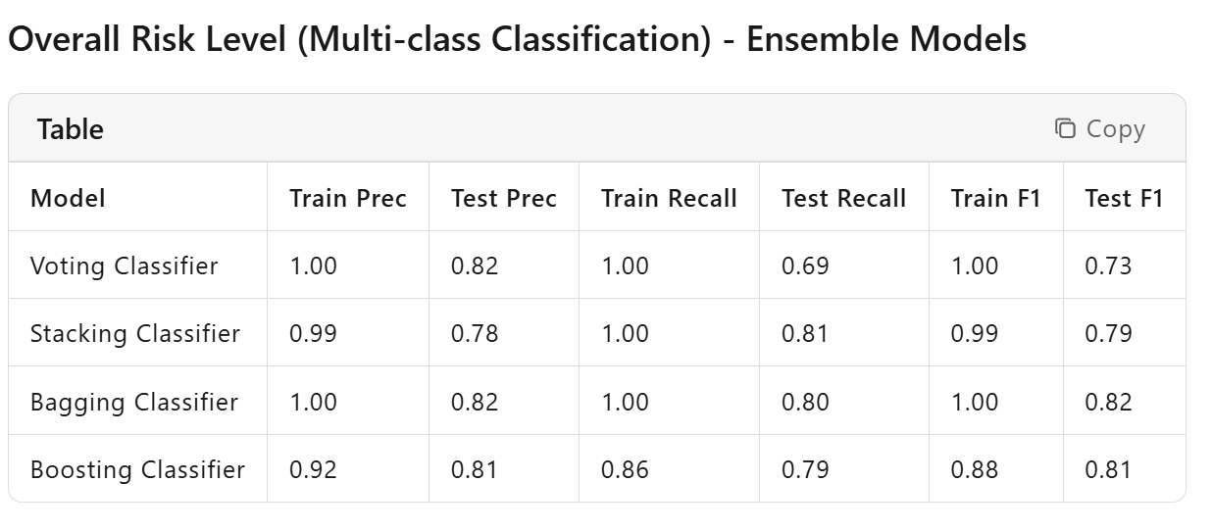
Ensemble ML models
Stacking Classifier is the best choice as it provides a good balance of precision, recall, and F1-score in testing. It achieves a macro-average precision of 0.78, recall of 0.81, and F1-score of 0.79.

Slide 25
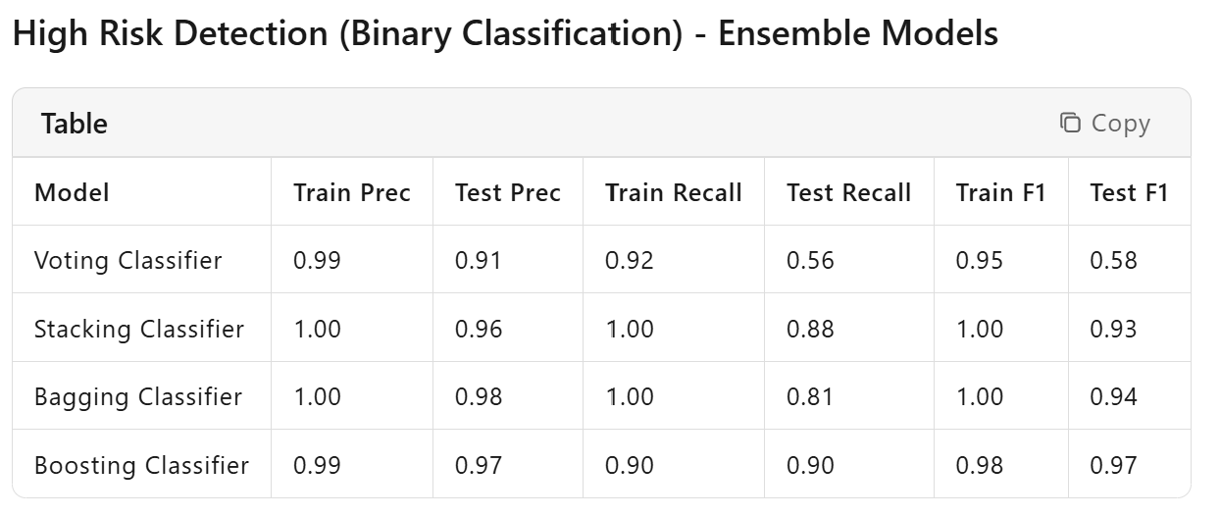
Ensemble ML models
Boosting Classifier is selected as the best model for high-risk detection. It attains the highest testing precision of 0.97, recall of 0.90, and F1-score of 0.97. This performance is particularly crucial for high-risk prediction where minimizing false negatives is essential.

Slide 26
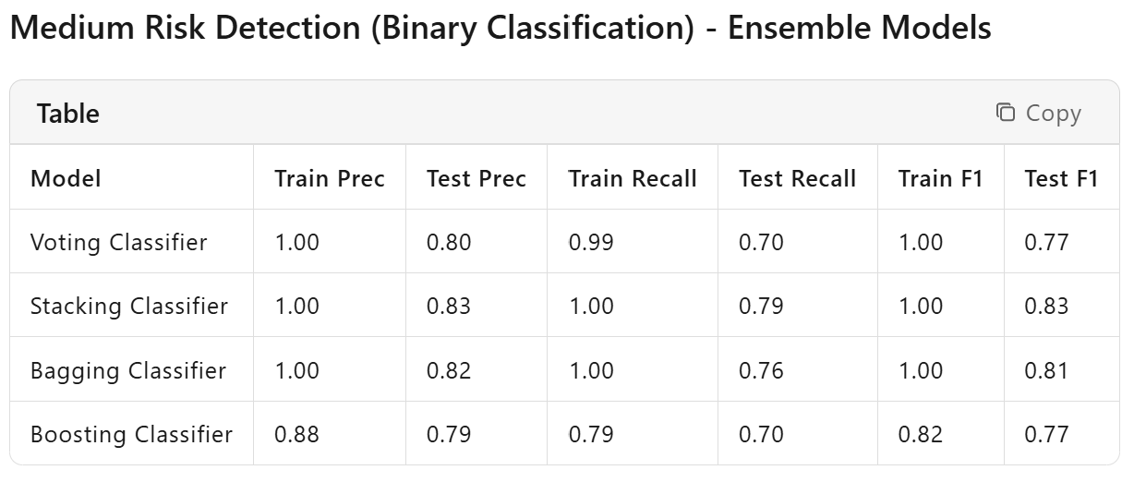
Ensemble ML models
Stacking Classifier is again the top choice here. It offers the best testing precision of 0.83, recall of 0.79, and F1-score of 0.83.

Slide 27
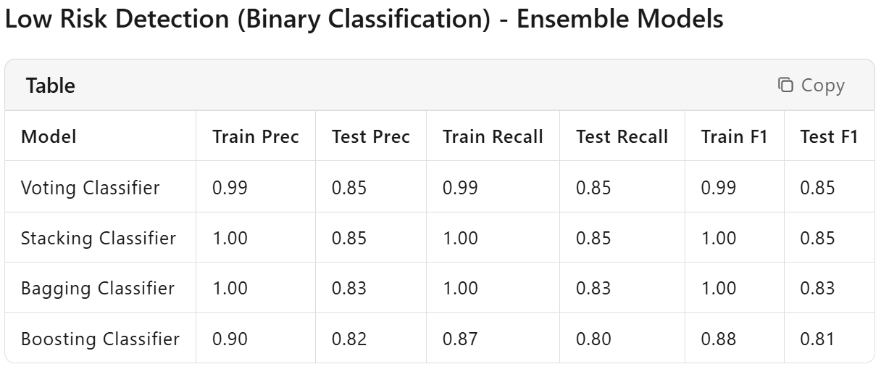
Ensemble ML models
Voting Classifier stands out with the best testing precision of 0.85, recall of 0.85, and F1-score of 0.85, making it the optimal model for low-risk detection.

Slide 28
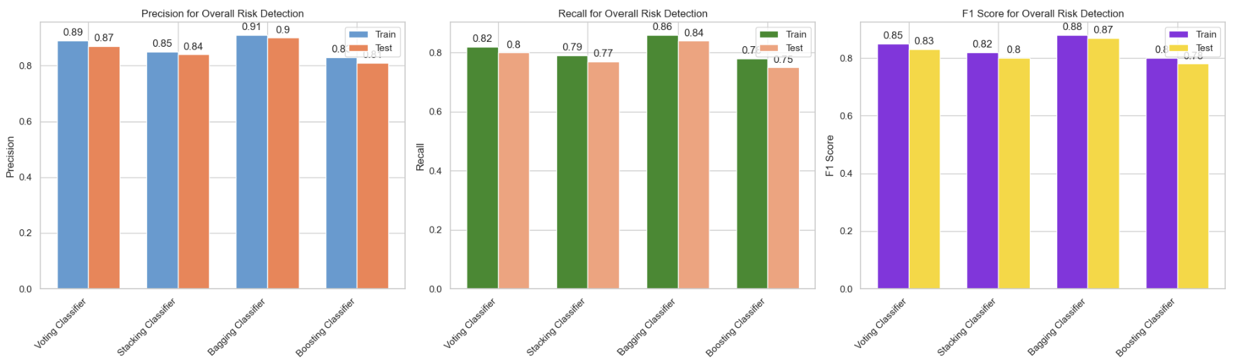
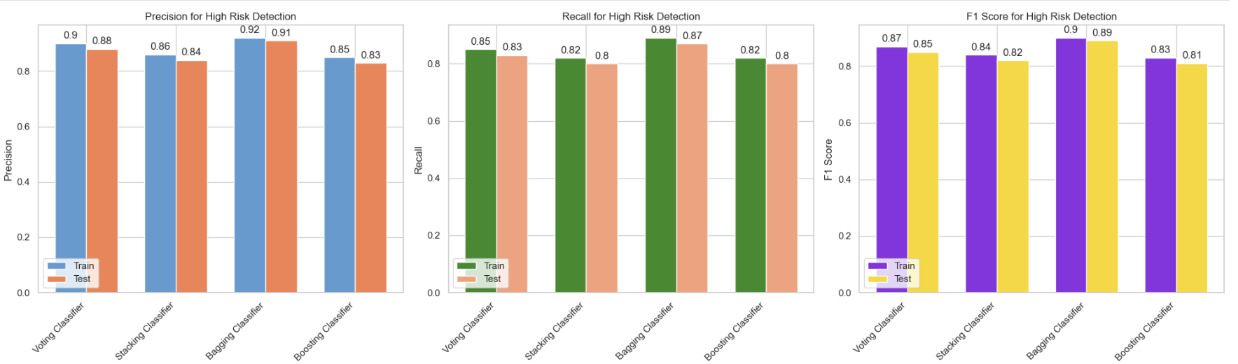
Ensemble ML models

Slide 29
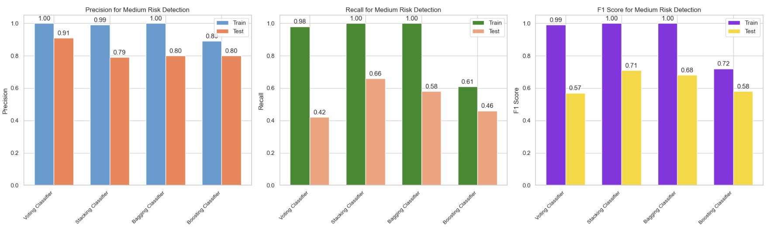
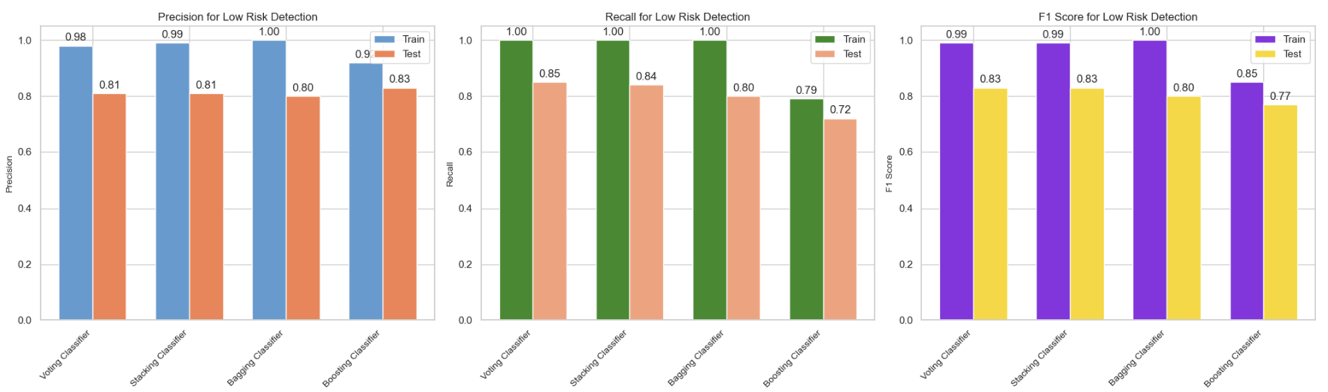
Ensemble ML models

Slide 30
Best Ensemble ML Models for Each Risk Level
Overall Risk Level: Stacking Classifier
High Risk Detection: Boosting Classifier
Medium Risk Detection: Stacking Classifier
Low Risk Detection: Voting Classifier

Slide 31
Deep Learning models

Slide 32
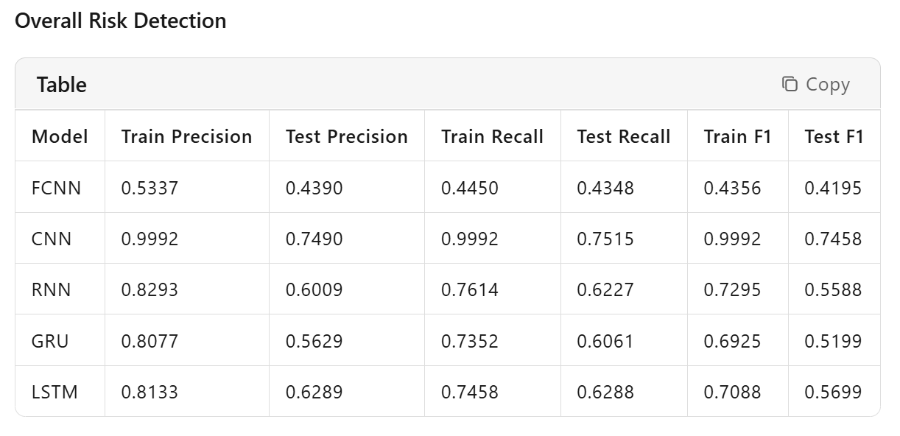
Deep Learning ML models
CNN achieves the highest testing precision (0.7490), recall (0.7515), and F1-score (0.7458) among the deep learning models for overall risk detection.

Slide 33
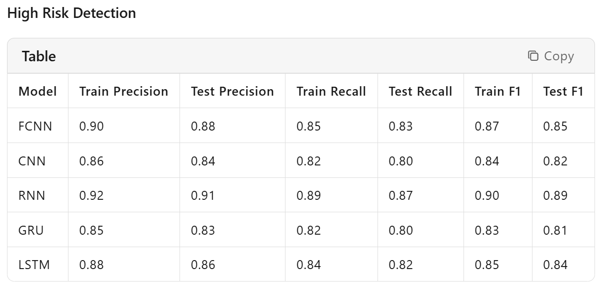
Deep Learning ML models
RNN demonstrates the best testing precision (0.91), recall (0.87), and F1-score (0.89) for high-risk detection, making it the optimal choice for identifying urgent cases.

Slide 34
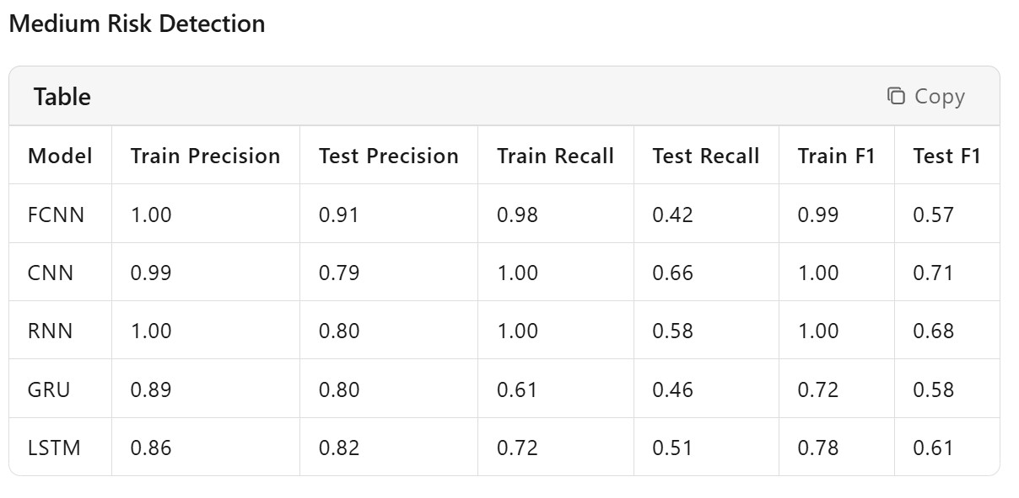
Deep Learning ML models
Despite some models having higher training metrics, CNN shows the best balance in testing with precision (0.79), recall (0.66), and F1-score (0.71), making it the most reliable for medium-risk detection.

Slide 35
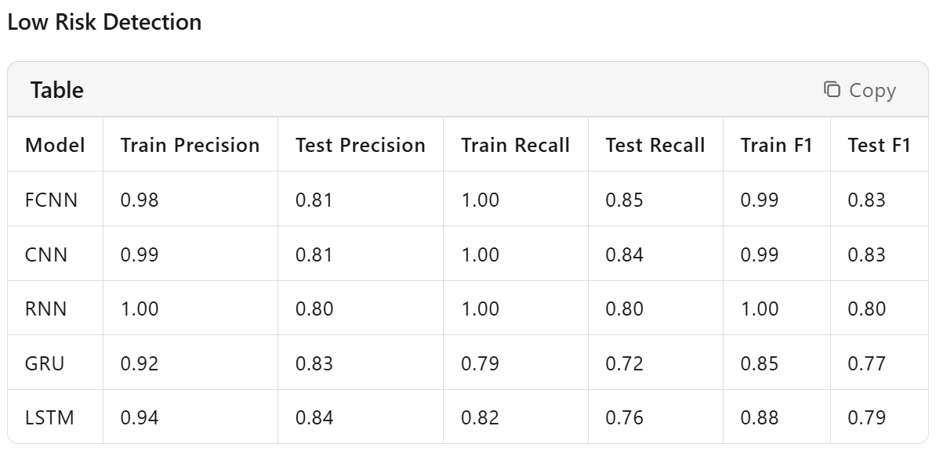
Deep Learning ML models
LSTM attains the highest testing precision (0.84), recall (0.76), and F1-score (0.79) for low-risk detection, providing the best performance in this category.

Slide 36
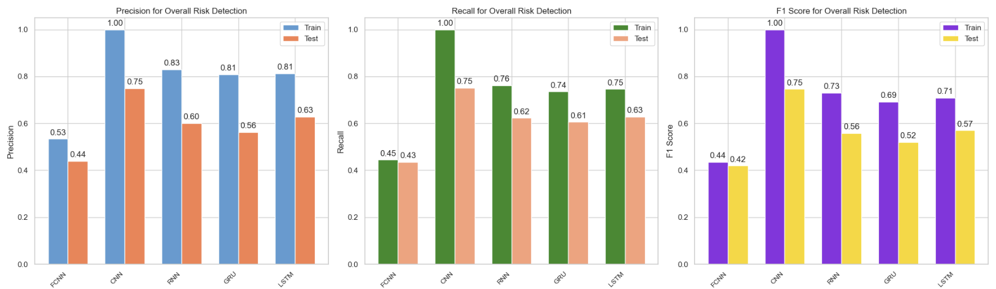
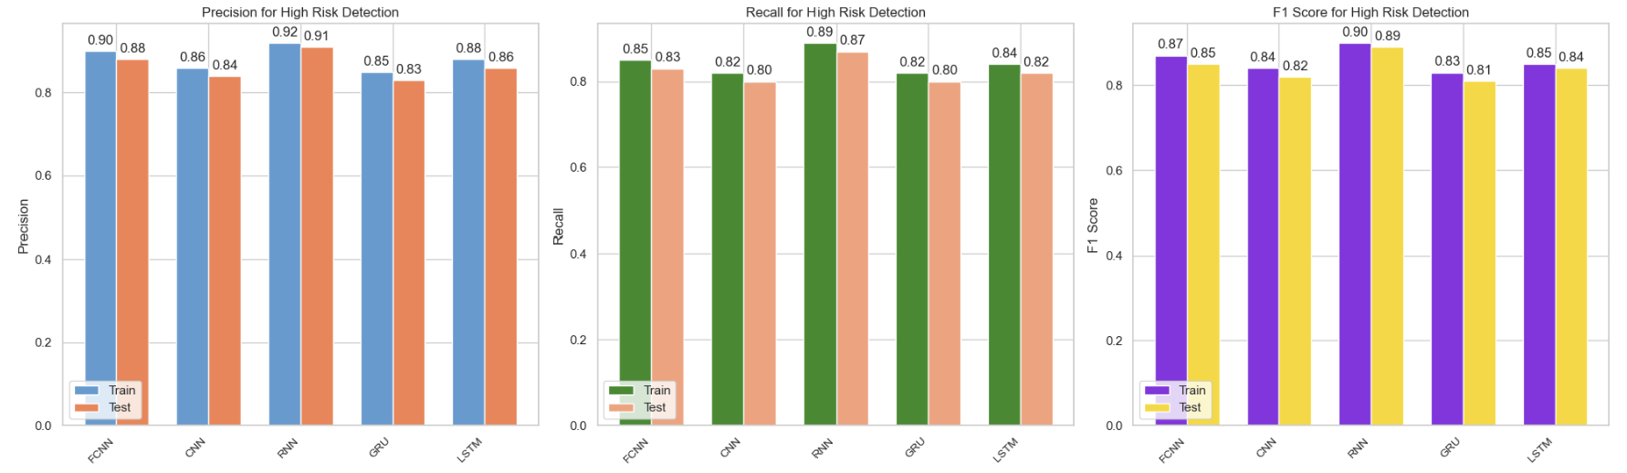
Deep Learning ML models

Slide 37
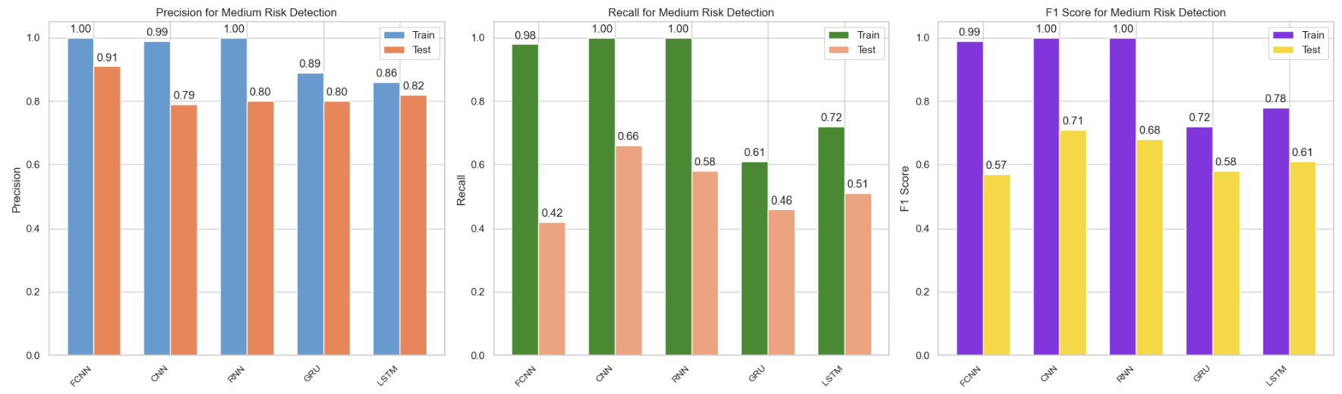
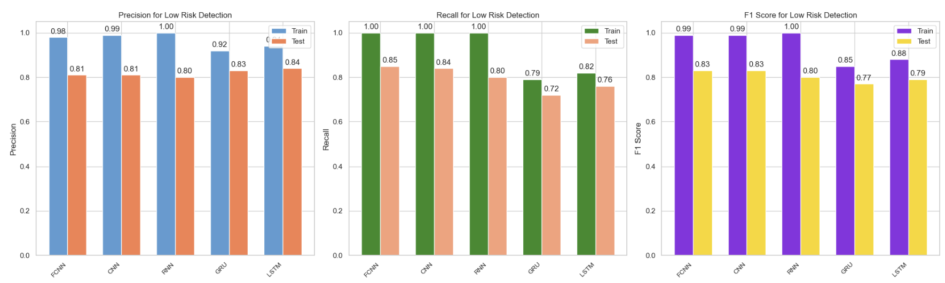
Deep Learning ML models

Slide 38
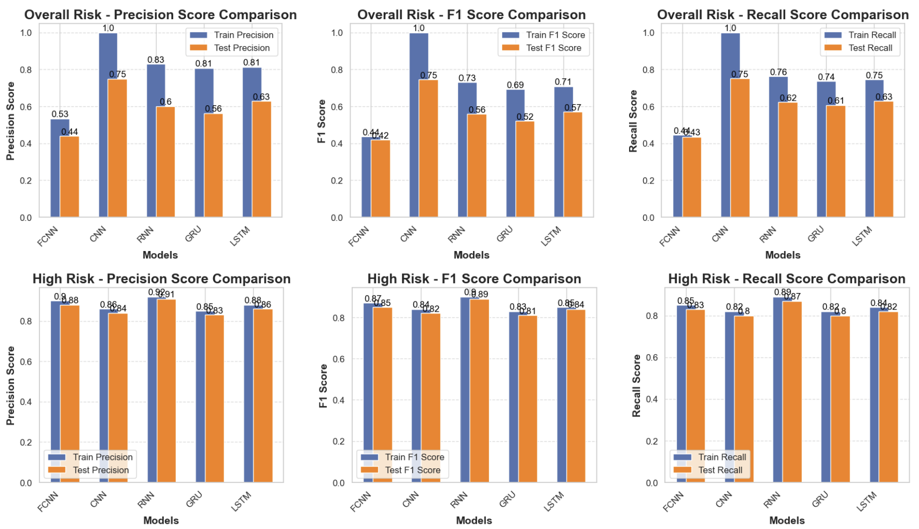
Deep Learning ML models

Slide 39
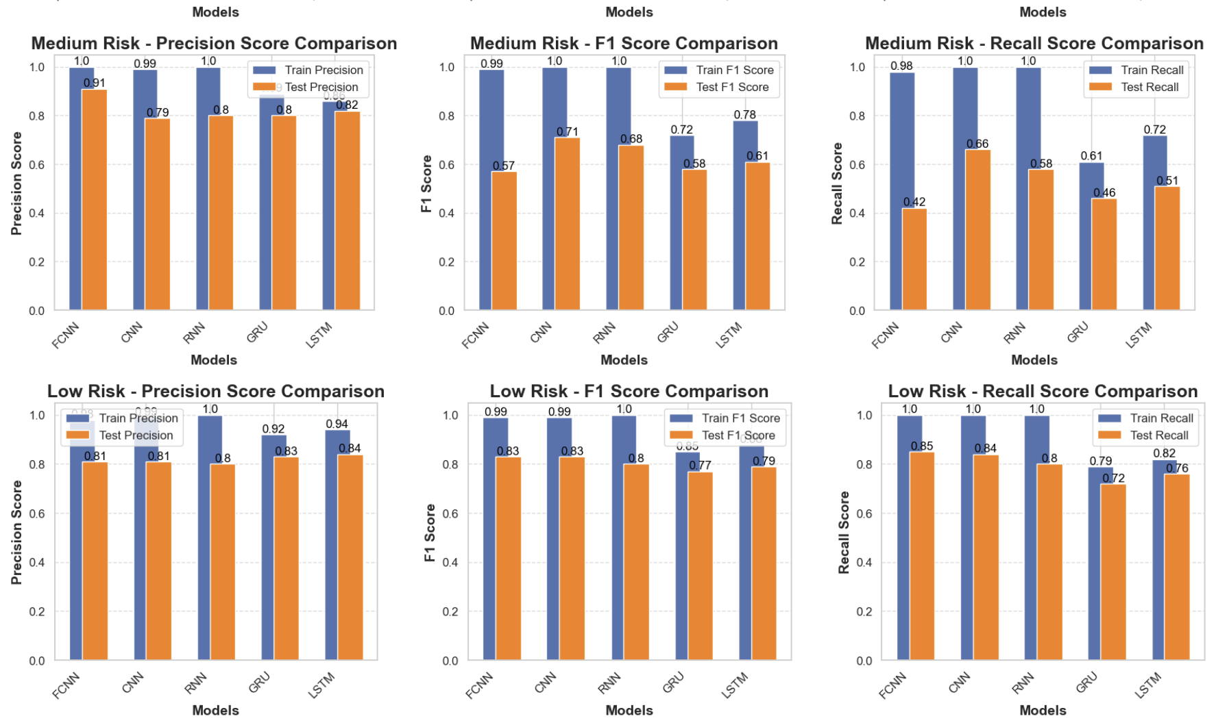
Deep Learning ML models

Slide 40
Best Deep Learning ML models for Each Risk Level
Overall Risk Level: CNN
High Risk Detection: CNN
Medium Risk Detection: CNN
Low Risk Detection: CNN
The CNN model achieves the highest precision, recall, and F1-score across all risk levels, making it the optimal choice for risk detection tasks in all categories.

Slide 41
Best Model for the NLP Suicide Post Prediction Project
Model: Stacking Classifier
Reason: Stacking Classifier combines the strengths of multiple models (e.g., SVM, LR, GB, DT) with a meta-classifier (e.g., Random Forest), which can enhance model performance and interpretability. It demonstrates robust performance across different risk levels and is particularly effective at handling imbalanced datasets.
From the results, the Stacking Classifier achieves a testing F1-score of 0.78 for overall risk detection, 0.85 for low risk, 0.80 for medium risk, and 0.96 for high risk. It offers a good balance between performance and computational efficiency, making it suitable for the NLP suicide post prediction task.

Slide 42
Why Not Other Models?
Deep Learning Models (CNN, LSTM/GRU/RNN): While they are effective at capturing complex text patterns, they are computationally intensive and may be overfit on smaller datasets. Given the potential limitations in computational resources and the need for model interpretability, deep learning models are less suitable in this scenario.
Traditional Models (Logistic Regression, Naive Bayes, SVM, Random Forest, Gradient Boosting): These models offer good performance but may not capture complex text patterns as effectively as ensemble models. For instance, while Random Forest and Gradient Boosting perform well, they do not consistently outperform the Stacking Classifier across all risk levels.
Other Ensemble Models (Voting Classifier, Bagging Classifier, Boosting Classifier): These models also provide strong performance, but the Stacking Classifier demonstrates a slight edge in balancing performance across different risk levels and handling imbalanced datasets.

Slide 43
Conclusion
The Stacking Classifier is chosen as the best model for the NLP suicide post prediction project due to its robust performance, ability to handle imbalanced datasets, and good balance between computational efficiency and model interpretability.
The project demonstrates the power of NLP and machine learning in addressing critical public health issues. By leveraging social media data, we can develop tools that potentially save lives.

